Slide 1
Chapter 13:
Installation and Operations

Slide 2
Objectives
Be familiar with the system installation process.
Understand different types of conversion strategies and when to use them.
Understand several techniques for managing change.
Be familiar with post-installation processes.

Slide 3
Introduction
Managing the change to a new system is one of the most difficult tasks in any organization
Conversion planning normally begins while the programmers are still coding
Change management focuses on people
Maintenance can account for 60-80% of IS budget

Slide 4
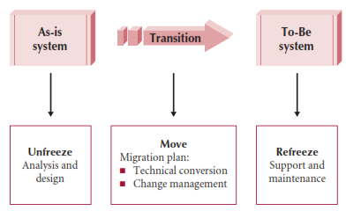
A Model for
Implementing Change

Slide 5
Cultural Issues and Information Technology
Factors that may affect adoption/acceptance of technology
  Speed of messages—may affect documentation & training
  Context: high context societies need to see how the new system fits in to existing systems
  Time: polychronic vs. monochronic (similar to parallel vs. serial)
  Power distance—can a subordinate point out errors?
  Uncertainty avoidance—related to risk and stress caused by change
  Individualism vs. collectivism—who is more important: the individual or the group?
  Masculinity vs. femininity
  Long- vs. short-term orientation—which is the focus: long term relationships or short term profits?

Slide 6
Conversion
Conversion is the technical process by which a new system replaces an old system
Three major steps to a conversion plan
  Buy & install hardware
  Install software
  Convert data
Conversion dimensions
  Conversion style—direct or parallel
  Conversion location—pilot, phased or simultaneous
  Conversion modules—whole system at once or one module at a time

Slide 7
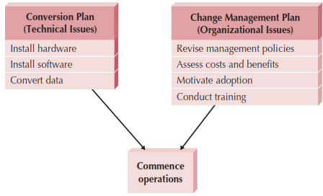
Elements of Migration Plan

Slide 8
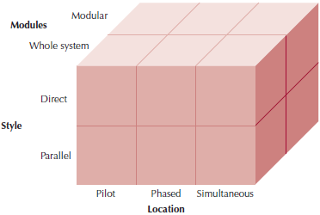
Conversion Strategies

Slide 9
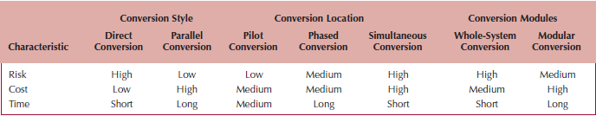
Selecting Conversion Strategies
Combine dimensions to form a strategy as needed
  Example: Begin with a pilot conversion using parallel conversion in a handful of locations; once successful, roll out to remaining locations using phased conversion
Prioritize risk, cost, and time; then refer to chart

Slide 10
Change Management
The process of helping people adopt & adapt to the to-be system and its accompanying work processes without undue stress
Key roles
  Sponsor
  Change agent
  Potential adopters
“Build it and they will come” doesn’t work!

Slide 11
Resistance to Change
What is good for the organization is often not good for the people in it
People perform their own personal cost-benefit analysis
  Perceived costs & benefits are weighted by the amount of uncertainty associated with them
  Most will overestimate costs and underestimate benefits
  Must take into account the transition process cost
  Perceived costs and benefits are more important than real costs and benefits

Slide 12
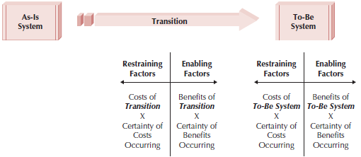
Costs & Benefits of Change

Slide 13
Revising Management Policies
Management policies
  Provide goals
  Define how work processes should be performed
  Determine how people are rewarded
No computer system will be successfully adopted unless management policies support its adoption

Slide 14
Work Process Structuring Tools
Standard Operating Procedures
  SOPs must be revised to match the to-be system
Measurements and Rewards
  Design to motivate desired (acceptance) behavior
Resource Allocation
  Direct effect is the actual reallocation of resources
  Symbolic effect shows that management is serious about the new system

Slide 15
Assessing Costs & Benefits
Develop a list of costs & benefits from two perspectives: the organization & the potential adopters
Consider the effects on both end-users and managers
Goal is to persuade those who might resist to support the change
  Significant management changes may be required to prevent grassroots derailing efforts
A successful organization may find it harder to manage change
  People need to be convinced that was has worked in the past may not work in the future

Slide 16
Motivating Adoption
Provide clear and convincing evidence of the need for change
Two basic strategies to motivate adoption
  Informational strategy
  Political strategy
Change management goal is to support and encourage the ready adopters and help them win over the reluctant adopters

Slide 17
Enabling Adoption: Training
Provide the skills needed to adopt the change
  Don’t assume the system is so simple to learn that new users need no training
What to train?
  Training should not focus on using the system
  Training should focus on helping the users accomplish their jobs
  Training should focus on what the user needs to do, not what the system is capable of doing
How to train?
  In groups in a classroom
  One on one
  Computer based training (CBT)

Slide 18
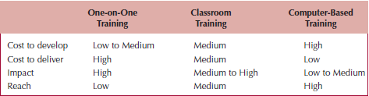
Selecting Training Methods

Slide 19
Post-implementation Activities
Goal is to institutionalize the new system
  Make it the normal & accepted routine
  “Refreeze” the organization after successful transition
Usually the job of the project sponsor and manager
  Actively promote its use and monitor its adoption
  Provide steady flow of information to users to encourage use

Slide 20
System Support
Now transition from project team to an operations group
  Responsible for operating the system & providing system support
Types of system support
  On-demand training
  Online support (e.g., documentation & FAQs)
  Help desk to provide expert advice
    Level I support should satisfy 80% of problems
    Unable to solve at level I:
      Generate problem report or ticket
      Escalate to Level II

Slide 21
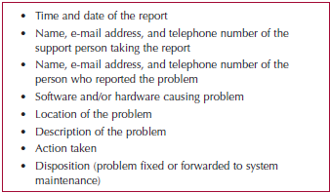
Elements of a Problem Report

Slide 22
System Maintenance
The process of refining the system to make sure it continues to meet business needs
More expensive than initial development
Novice system analysts & programmers will work on maintenance projects
Change requests are smaller versions of a system request
Requests may come from a number of different sources
  Problem reports
  Users
  Other projects
  Underlying software (e.g., Operating System changes)
  Senior management

Slide 23
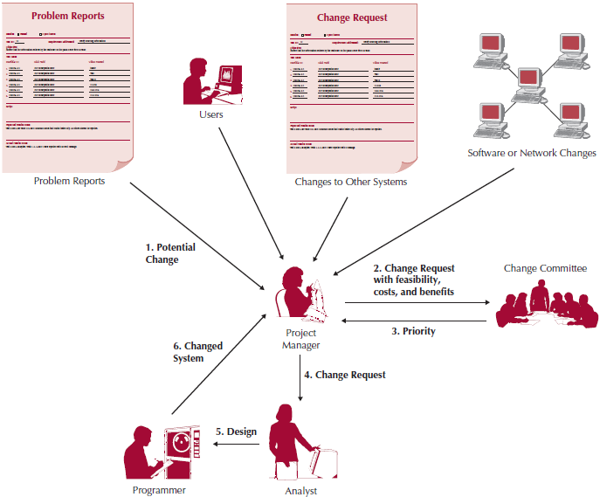
Processing a Change Request

Slide 24
Project Assessment
Determine what was successful and what needs to be improved
  Project Team Review
    Members list what worked and mistakes that were made
    Goal is to repeat excellent performance and eliminate mistakes
    Project manager can prepare a “lessons learned” document
  System Review
    To what extent did the proposed costs & benefits actually accrue
    Goal is to compare estimates with actual values
      Determine whether or not the system provides the expected value
      Provide baseline costs for future projects

Slide 25
Summary
Cultural Issues and Information Technology
Conversion
Change Management
Post-implementation Activities

